Slide 1


Our client's satisfaction is critical for us.
Introduction
Orion
Introduction

Slide 2
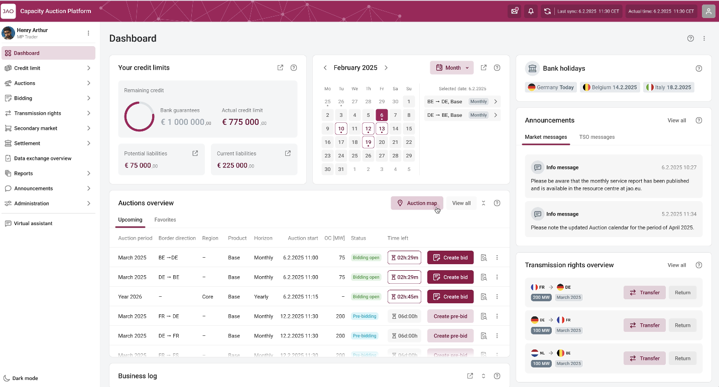
Objectives
* Preliminary mockup design not reflecting the final product
JAO engaged as part of their Corporate Strategic Objectives to improve explicit auction experiences.
A new Auction Platform with the following in mind:
User Experience: it must be fast, intuitive, appealing and streamlined
Stability and performance: it must be reliable and support market constraints whatever the volume
Integrability and automation: API first architecture design as part of its fundamentals for ease and standardization of integration.
Autonomy: integration of ease of life feature for clients
Unicorn has been selected as the provider and the platform will be named Orion

Slide 3
Roadmap
2025
2026
2027
April 2025: project kickoff
Dec 2026:
Technical readiness and deployment
Sept 2027:
Go-Live
Q4 2027:
hyper care
Q2-2025-Q2 2026: Agile Design phase (Detailed specification, UX, UI, flows, integrations…)
Q3 2025 -> Q4 2026:
Agile Implementation and validation phase
01/2027 -> Q2/3 2027:
Testing phases (Int. TSOs, MPs…), training (Int. MPs, TSOs…), Operations readiness
Q3 2026 -> Q4 2026:
Infrastructure setup and availability/recoverability
Q3 2027:
Data migration and Go-live sign-off
Post-Q4 2027: Optimization and Ongoing Enhancements
Continue leveraging platform flexibility for continuous improvement.
Q3 2025 -> Q2 2027:
Parallel project integration process

Slide 4
Orion – The new allocation tool
HARMONIZED AUCTION CALENDAR
INVOICES
DASHBOARD
NOTIFICATIONS
Use cases
DISPLAY AUCTIONS
REST
API
SETTLEMENTS
User
Account management

Slide 5
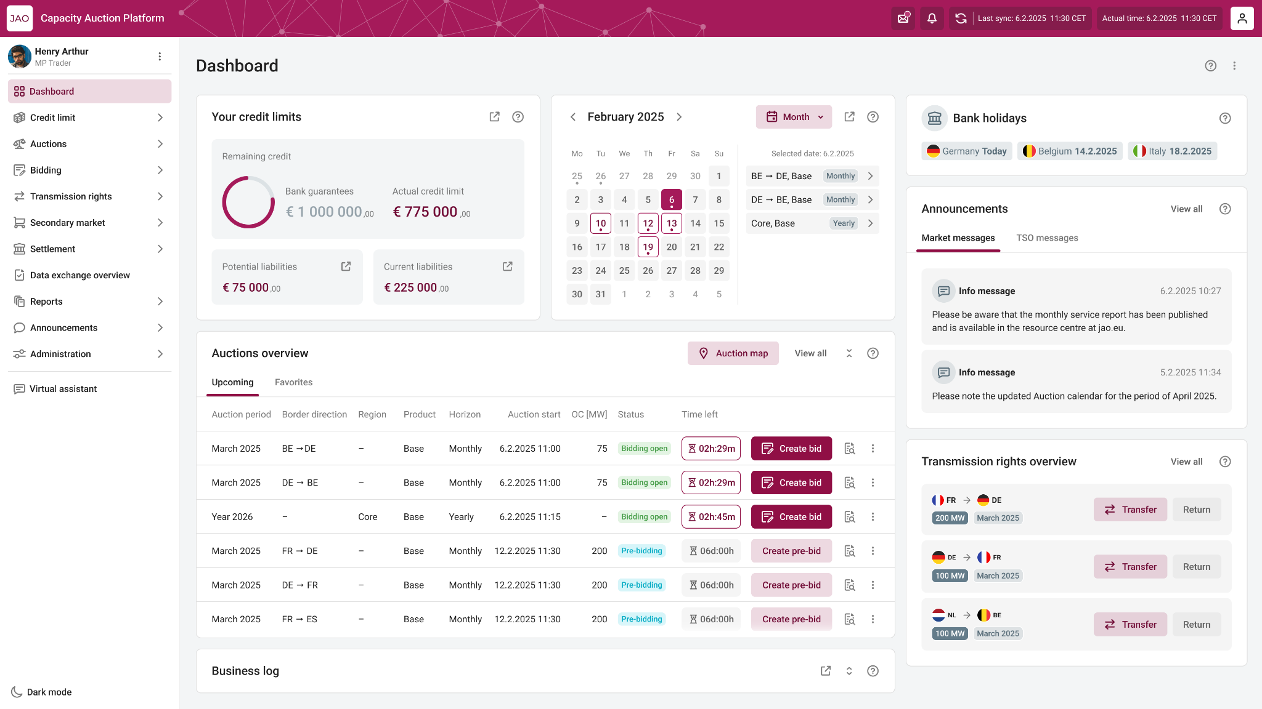

Main Changes
Dashboard
What are the new API, is there any change in the xml structure?
Multi Factor Authentication
Primary Authorized Person
No emails, output files
JSON-based payloads via REST API
Machine users hold certificate
Machine users hold certificate

Slide 6

Upcoming Activities
Connectivity test – Phase 1
‘26
Sept.
With three User Group members
Connectivity test – Phase 2
‘26
Nov.
With all User Group members
Connectivity test – Phase 3
‘27
Jan.
With every Market Participants

Slide 7
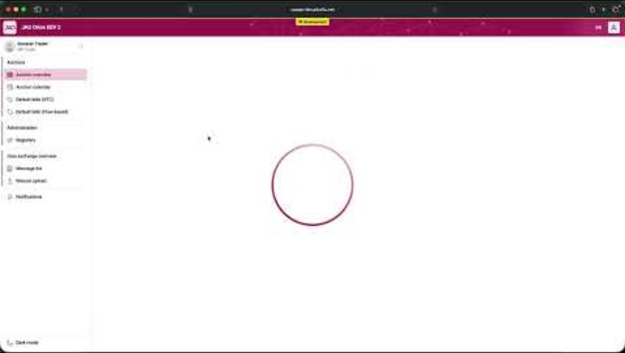

Slide 8

JAO
Support Hub

Slide 9




JAO Support Hub
More than a ticketing platform
Ticketing
Registration
Account management
Digitalized, seamless processes

Slide 10
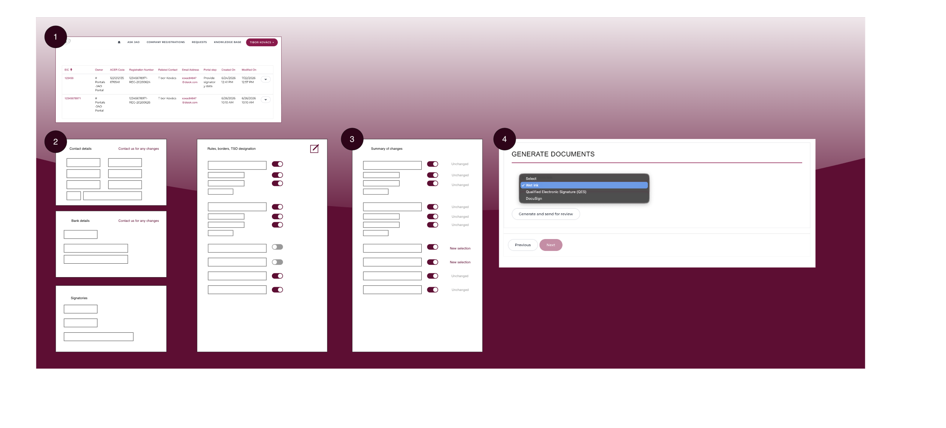

Slide 11

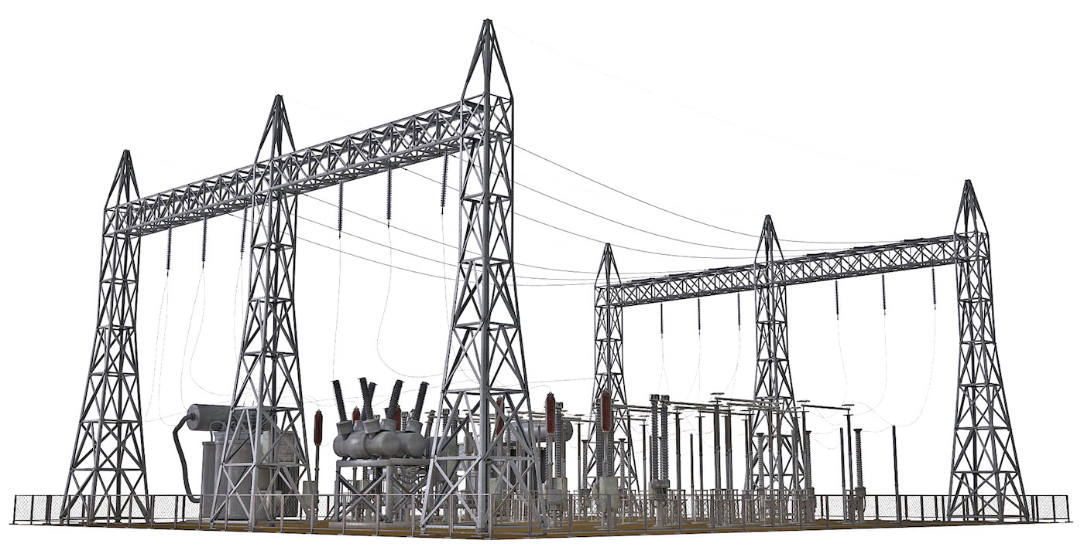
Q & A

Slide 12

Thank you!

