Slide 1


Our client's satisfaction is critical for us.
Introduction
Open Call
08.09.2026

Slide 2

Introduction

Slide 3

Agenda
1. Projects overview
2. Auction Calendar
3. Short News
4. Orion
5. JAO Support Hub
6. Q & A

Slide 4
Projects overview

Slide 5

Projects
2026
North Sea Link
Long-term auctions
17.09
JAO Support Hub
Intraday Auction on the Ukrainian borders (?)
PTR to FTR switch
on North Italy borders
IT<>AT, IT<>FR, IT<>SI
21.09
Long Term Flow Based Allocation
30.11
Project Pelagonia
GR-MK
Explicit auctions
North Sea
November
01.01

Slide 6
LTFBA Status Overview
Highlights
eCAT:
  eCAT Development of the baseline scope and the additional change request package have been completed
  Training and 2 Rounds of Functional Testing completed successfully with signoff from all TSOs and RCCs
  Procedural Testing in progress – Rounds 1, 2 and 3 completed – 4th round due for completion mid September
Publication Tool:
  Development for Core and Nordics Completed as per approved scope with some final clarifications pending
  on Nordics Congestion Income Page.
  Files now being sent by Nordic RCC successfully and Functional Testing is in Progress.
External Parallel Run:
  LTFBA and LTCC combined parallel run in progress.
SAP (Invoicing Tool):
  Implementation Guide Approved
  Development on Track and aligned with Testing timeline.
  Post coupling process not linked to regulatory milestone for LTFBA

Slide 7
Roadmap
Activity​ | Aug​ 25​ | Sep​ 25​ | Oct​ 25​ | Nov​ 25​ | Dec​ 25​ | Jan​ 26​ | Feb​ 26​ | Mar​ 26​ | Apr​ 26​ | May​ 26​ | Jun​ 26​ | Jul​ 26​ | Aug​ 26​ | Sep​ 26​ | Oct​ 26​ | Nov​ 26​ | Status​
Simulation Platform​ | ​ | ​ | ​ | ​ | ​ | ​ | ​ | ​ | ​ | ​ | ​ | ​ | ​ | ​ | ​ | ​ | 100%​
eCAT​ | ​ | ​ | ​ | ​ | ​ | ​ | ​ | ​ | ​ | ​ | ​ | ​ | ​ | ​ | ​ | ​ | 70%​
MP Testing*​ | ​ | ​ | ​ | ​ | ​ | ​ | ​ | ​ | ​ | ​ | ​ | ​ | ​ | ​ | ​ | ​ | 70%​
Website & Publication Tool​ | ​ | ​ | ​ | ​ | ​ | ​ | ​ | ​ | ​ | ​ | ​ | ​ | ​ | ​ | ​ | ​ | 80%​
Go Live (Regulatory)​ | ​ | ​ | ​ | ​ | ​ | ​ | ​ | ​ | ​ | ​ | ​ | ​ | ​ | ​ | ​ | ​ | ​
Test w. MPs
SIT – RCCs, TSOs
9th & 10th
5th & 6th
4th , 9th & 10th
SIT – RCCs, TSOs
LTCC and LTFBA Publication Tool Ext Parallel Run
*2 rounds of MP Testing completed in July and August. A third round will be taking place from the 4th of September.
Ahead of each activity JAO will formally issue comms to Market Participants with more information regarding their involvement. Dates are to be confirmed but will include timings and details of workshops and alignments, engagement forums and format.

Slide 8

LTFBA
Supporting documents
ACER and ENTSO-E organized online workshops regularly to align on strategically important topics shaping the long-term flow-based allocation of transmission capacities.
So far, 8 workshops have been organized. The topics and supporting documents of these workshops, including the links of the event pages available on JAO’s website.

Slide 9
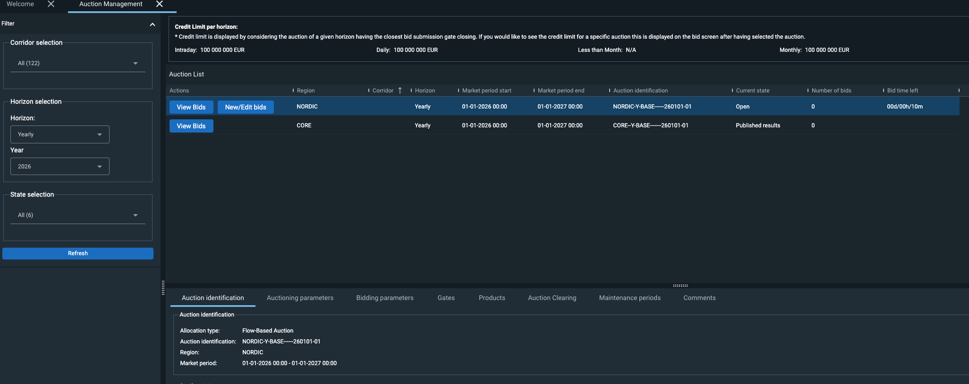

Slide 10
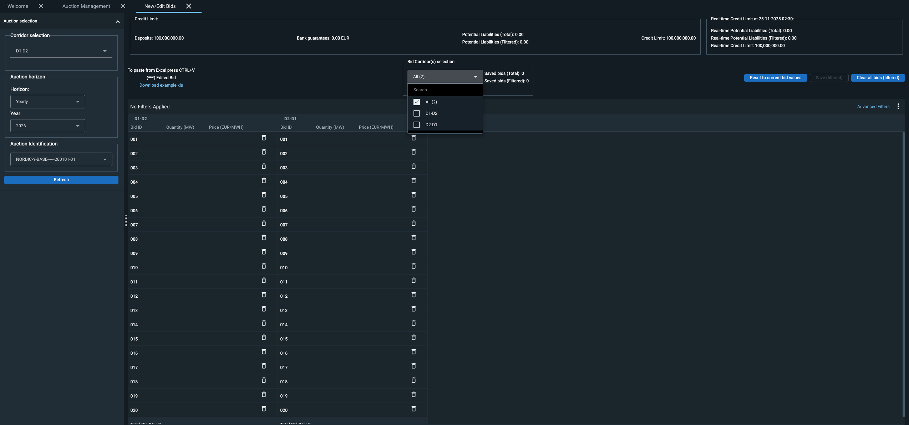

Slide 11
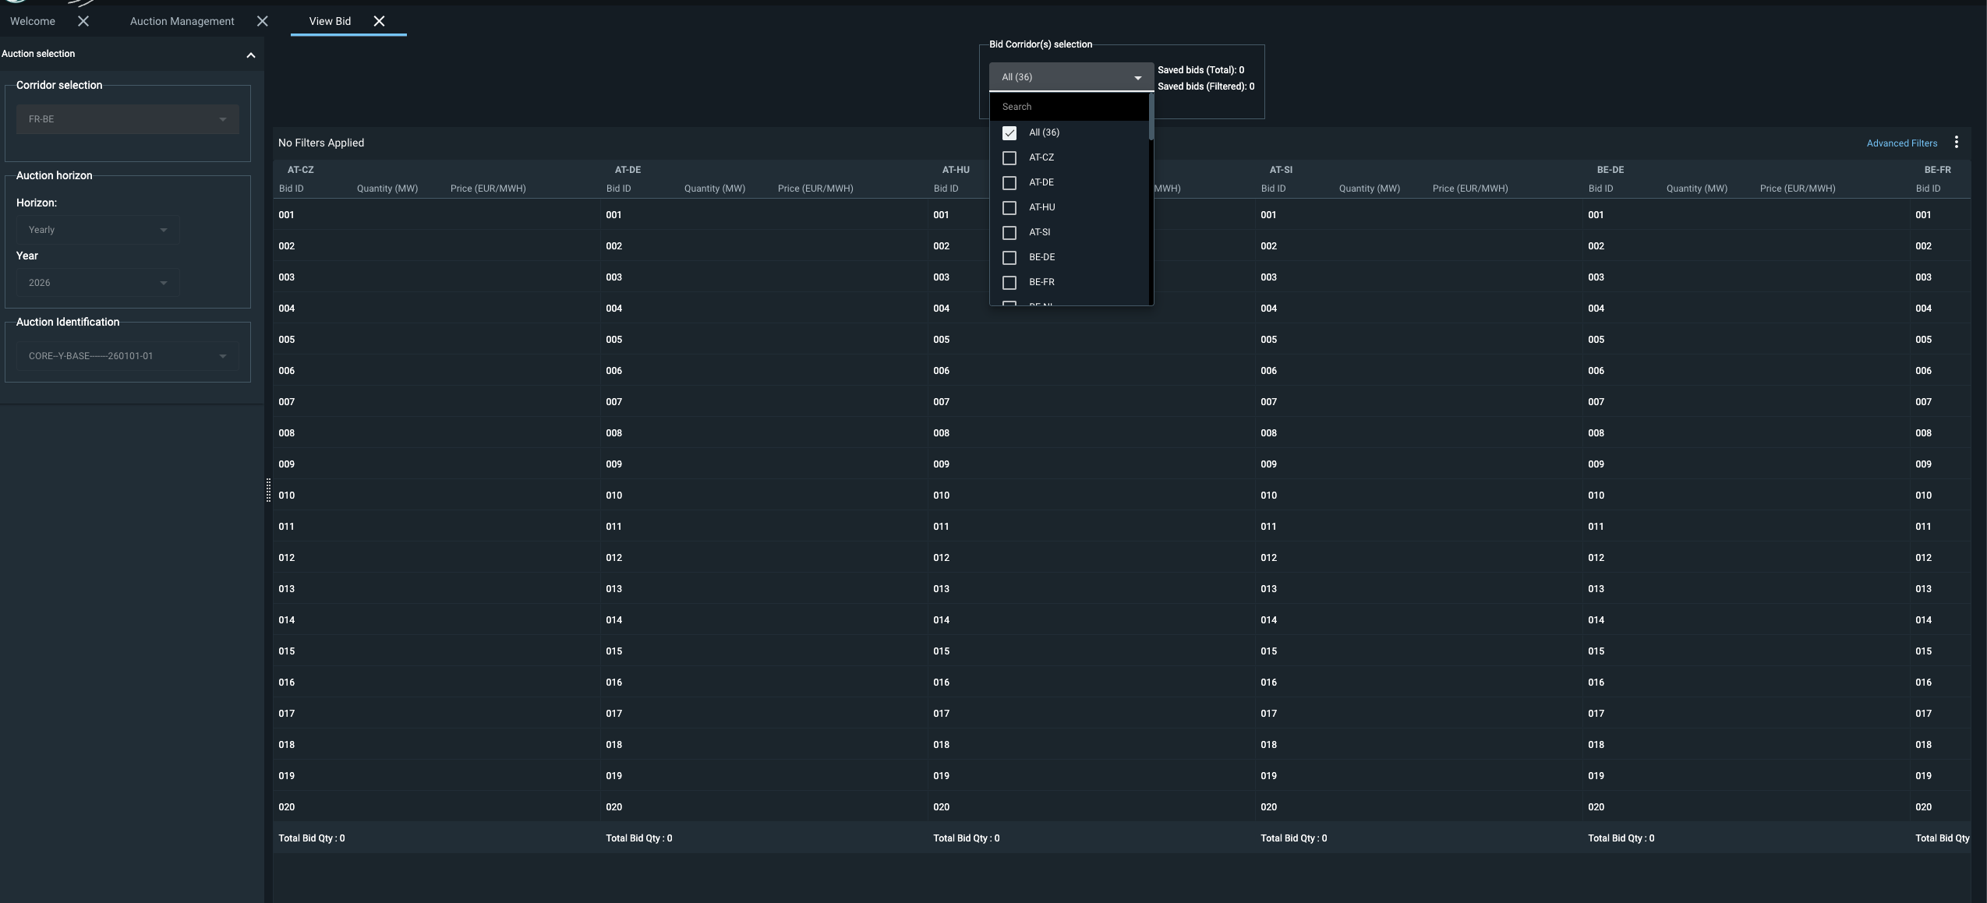

Slide 12
Short News

Slide 13

Short News
New Feedback collections approach -No more Annual Surveys
Public release notes
15 Min MTU new roadmap is under assessment

Slide 14
Auction Calendar

Slide 15

Certificate reviewal
Credit limit management
Auction Calendar 2027 in mid-October
Y+2 auction Switzerland – Italy auction

Slide 16
2027
Auction Calendar
Nemolink
Y Base 8 – 2027
Denmark – Netherland
Y Base 1 – 2027
Switzerland - France
Y Base 2 – 2027
16.09.2026
16.09.2026
23.09.2026
15.09.2026
23.09.2026
24.09.2026
Spain-France
Y Base 1 – 2027
Viking Link
Y Base 3 – 2027
IFA2
Y Base 6 – 2027

Slide 17

2028
Auction Calendar
Eleclink
Y Base 4 – 2028
Nemolink
Y Base2 – 2028
Nemolink
Y Base 3 – 2028
09.09.2026
16.09.2026
13.10.2026
10.09.2026
22.09.2026
17.11.2026
IFA1
Y Base 2 – 2028
Eleclink
Y Base 3 – 2028
IFA2
Y Base 2 – 2027

Slide 18
Orion

Slide 19
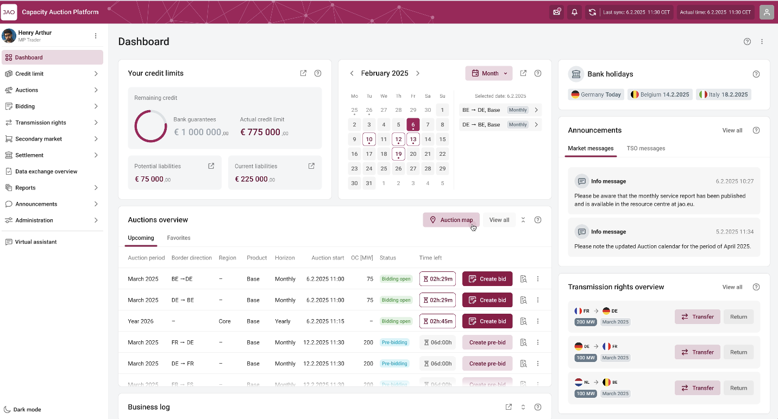
Objectives
* Preliminary mockup design not reflecting the final product
JAO engaged as part of their Corporate Strategic Objectives to improve explicit auction experiences.
A new Auction Platform with the following in mind:
User Experience: it must be fast, intuitive, appealing and streamlined
Stability and performance: it must be reliable and support market constraints whatever the volume
Integrability and automation: API first architecture design as part of its fundamentals for ease and standardization of integration.
Autonomy: integration of ease of life feature for clients
Unicorn has been selected as the provider and the platform will be named Orion

Slide 20
Roadmap
2025
2026
2027
April 2025: project kickoff
Dec 2026:
Technical readiness and deployment
Sept 2027:
Go-Live
Q4 2027:
hyper care
Q2-2025-Q2 2026: Agile Design phase (Detailed specification, UX, UI, flows, integrations…)
Q3 2025 -> Q4 2026:
Agile Implementation and validation phase
01/2027 -> Q2/3 2027:
Testing phases (Int. TSOs, MPs…), training (Int. MPs, TSOs…), Operations readiness
Q3 2026 -> Q4 2026:
Infrastructure setup and availability/recoverability
Q3 2027:
Data migration and Go-live sign-off
Post-Q4 2027: Optimization and Ongoing Enhancements
Continue leveraging platform flexibility for continuous improvement.
Q3 2025 -> Q2 2027:
Parallel project integration process

Slide 21
Orion – The new allocation tool
HARMONIZED AUCTION CALENDAR
INVOICES
DASHBOARD
NOTIFICATIONS
Use cases
DISPLAY AUCTIONS
REST
API
SETTLEMENTS
User
Account management

Slide 22
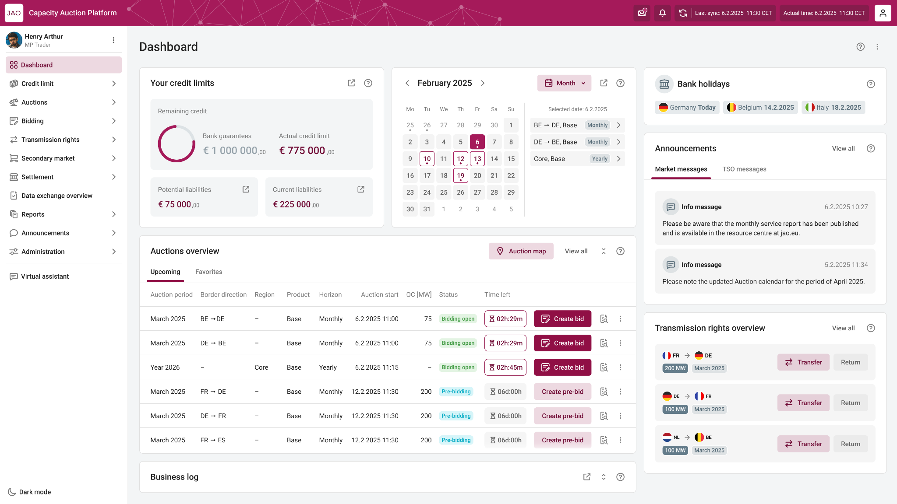

Main Changes
Dashboard
What are the new API, is there any change in the xml structure?
Multi Factor Authentication
Primary Authorized Person
No emails, output files
JSON-based payloads via REST API
Machine users hold certificate
Machine users hold certificate

Slide 23

Upcoming Activities
Connectivity test – Phase 1
‘26
Sept.
With three User Group members
Connectivity test – Phase 2
‘26
Nov.
With all User Group members
Connectivity test – Phase 3
‘27
Jan.
With every Market Participants

Slide 24
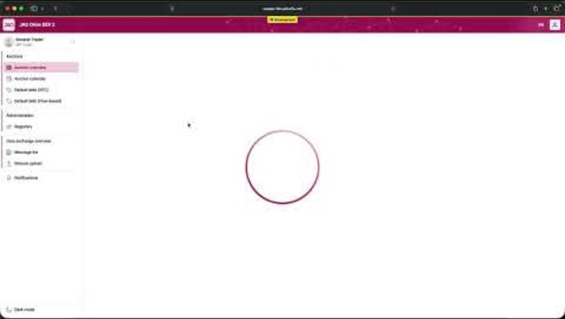

Slide 25
JAO
Support Hub

Slide 26




JAO Support Hub
More than a ticketing platform
Ticketing
Registration
Account management
Digitalized, seamless processes

Slide 27
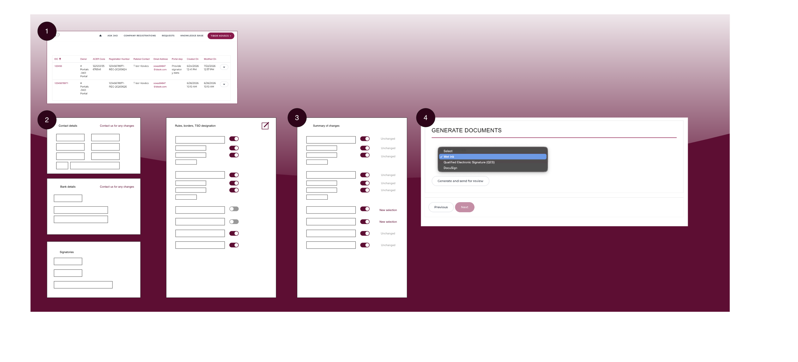

Slide 28

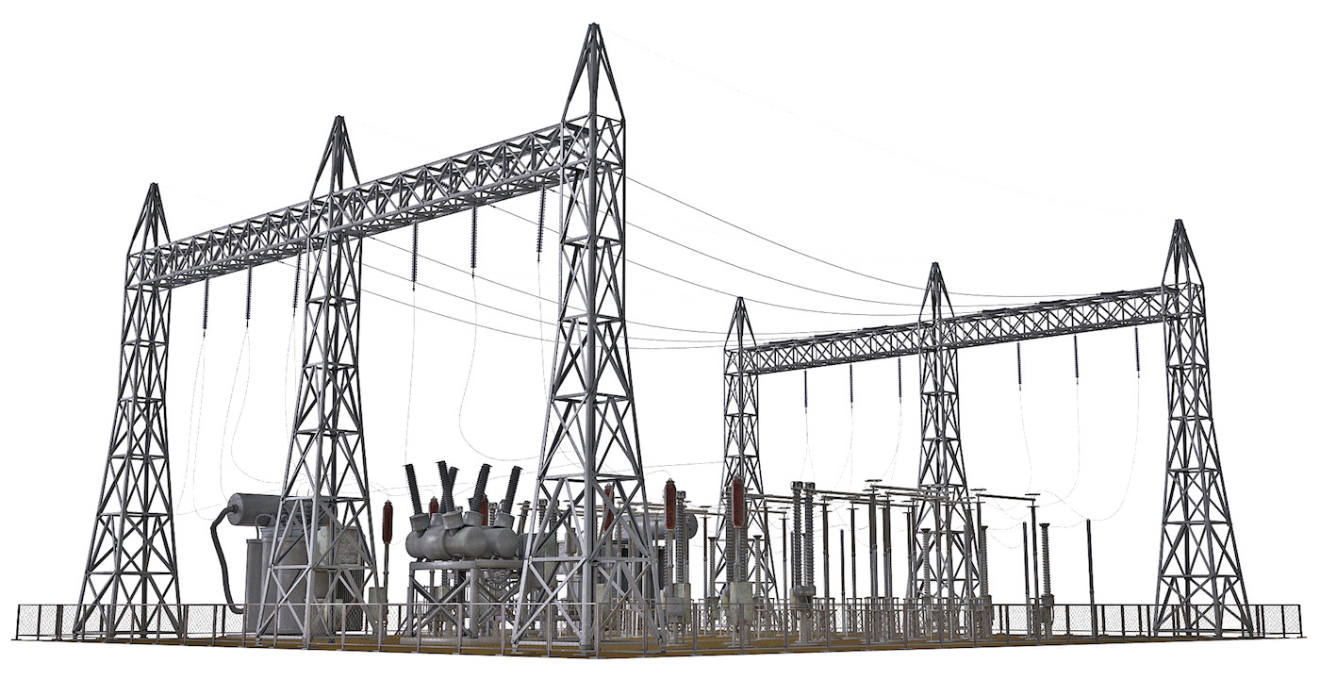
Q & A

Slide 29

Thank you!

